Slide 1

CSCI 476: Computer Security
Threat Modeling, Lessons Learned, Review
Reese Pearsall
Fall 2023
*all images are stolen from the internet
https://www.cs.montana.edu/pearsall/classes/fall2023/476/main.html

Slide 2
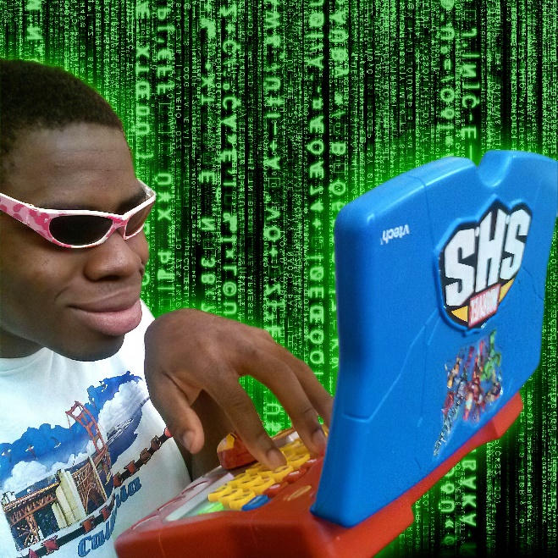
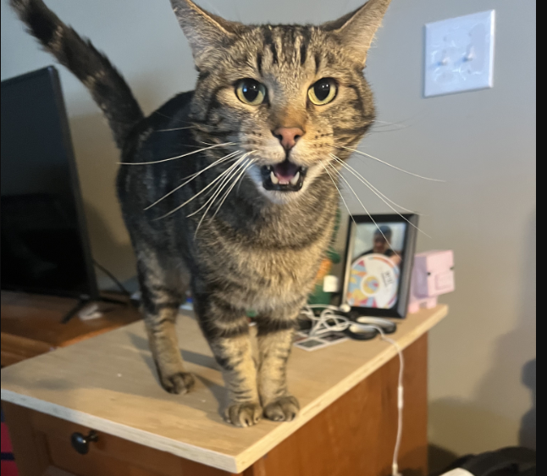
Announcements
students after completing CSCI 476
Lab 9 due Sunday 12/10
Fill out the course evaluation (Extra Credit)
Final Exam
Thursday December 14th 2:00 – 3:50 in Romney 315
Please be there
If you are taking the exam at the testing center, make sure you schedule it before friday
Meatball wishes you good luck on your final exams

Slide 3


Slide 4


Slide 5


Slide 6
Security Basics
The CIA Triad is a widely accepted model for evaluating the security of a system. Consists of three important principles
CIA Triad

Slide 7

Security Basics
C
The CIA Triad is a widely accepted model for evaluating the security of a system. Consists of three important principles
confidentiality
Confidentiality- protection from unauthorized access
CIA Triad

Slide 8

Security Basics
C
The CIA Triad is a widely accepted model for evaluating the security of a system. Consists of three important principles
confidentiality
Confidentiality- protection from unauthorized access
Integrity- protection from unauthorized modifications
I
CIA Triad
integrity

Slide 9

Security Basics
C
The CIA Triad is a widely accepted model for evaluating the security of a system. Consists of three important principles
confidentiality
Confidentiality- protection from unauthorized access
Integrity- protection from unauthorized modifications
I
CIA Triad
A
Availability- protection from interruption
integrity
availability

Slide 10
Common Threats & Attack Vectors
Denial of Service (DoS / DDos)- attack with intent to shut down a machine or network
Violates the availability property

Slide 11
Common Threats & Attack Vectors
Denial of Service (DoS / DDos)- attack with intent to shut down a machine or network
Violates the availability property
Information Leakage / Data Corruption- unauthorized or accidental reveal of sensitive information
Violates the confidentiality property
Violates the integrity property

Slide 12
Common Threats & Attack Vectors
Denial of Service (DoS / DDos)- attack with intent to shut down a machine or network
Violates the availability property
Information Leakage / Data Corruption- unauthorized or accidental reveal of sensitive information
Violates the confidentiality property
Violates the integrity property
Privilege Escalation- gaining illicit permissions beyond what is intended for that user
Violates the confidentiality property
Violates the integrity property

Slide 13


Defense Mechanisms
Countermeasures (ASLR, SYN Cookies, etc)
Software testing
Formal verification
Refactoring software and safe coding practices

Slide 14
Threat Modeling
NEED: a consistent and structured approach for defense and assessing risk

Slide 15
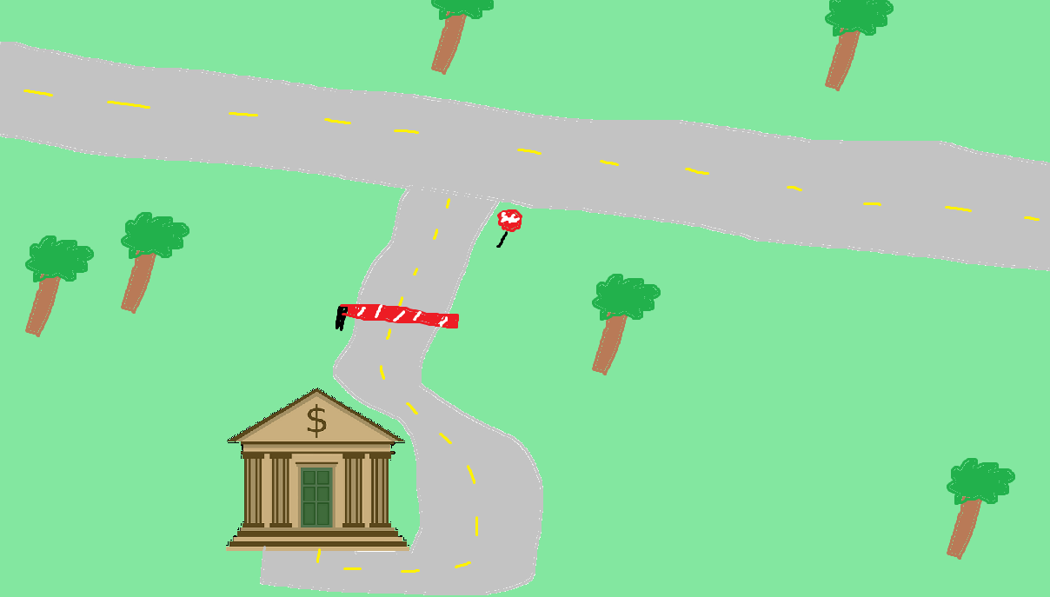


Assessing Risk
We expect users to interact with our system in a certain way

Slide 16
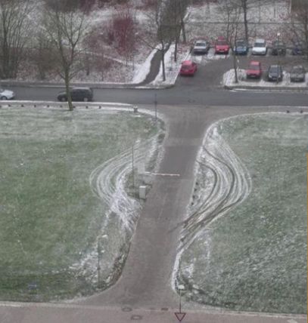

Assessing Risk
We expect users to interact with our system in a certain way
When someone interacts with our system in a way that we did not intend… it could have harmful consequences

Slide 17
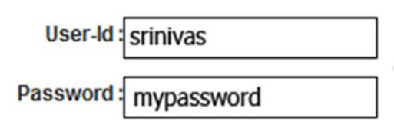
Assessing Risk
We expect users to interact with our system in a certain way
We might expect a user to input a valid username and password when they attempt to log in
When someone interacts with our system in a way that we did not intend… it could have harmful consequences

Slide 18
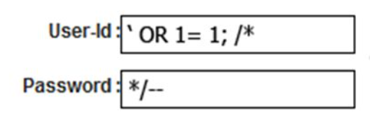
Assessing Risk
We expect users to interact with our system in a certain way
We might expect a user to input a valid username and password when they attempt to log in
When someone interacts with our system in a way that we did not intend… it could have harmful consequences
What if they did something…….. weird?

Slide 19
Assessing Risk
We expect users to interact with our system in a certain way
We might expect a user to input a valid username and password when they attempt to log in
When someone interacts with our system in a way that we did not intend… it could have harmful consequences
What if they did something…….. weird?
LOGIN SUCCESS

Slide 20
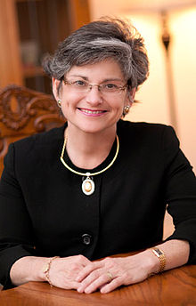

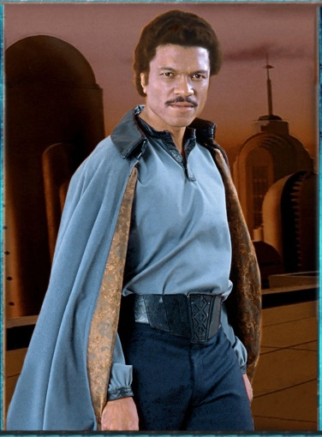


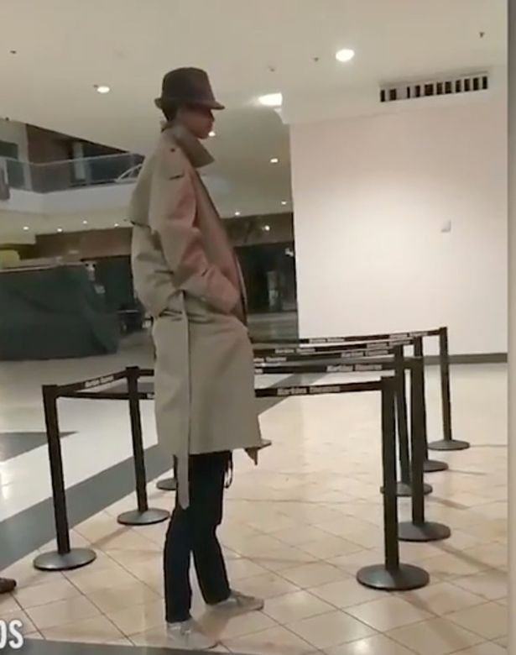


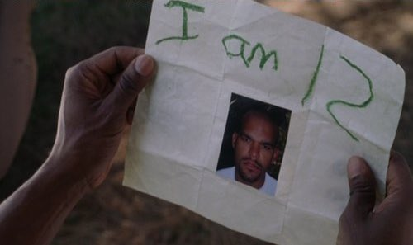

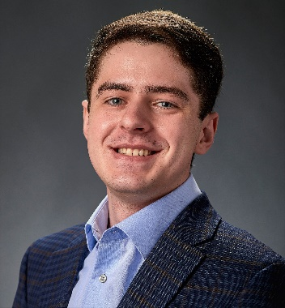
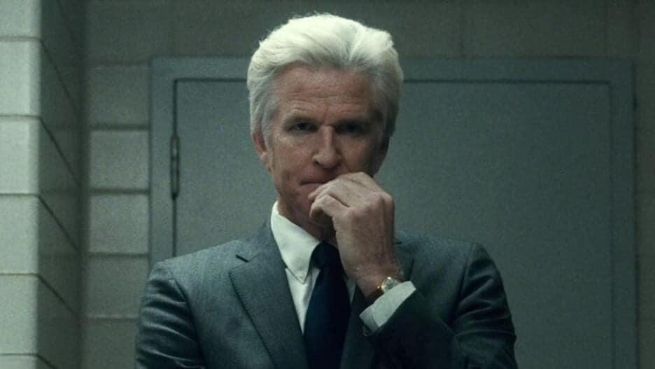
Who do we trust?
Are they honest? Are they reliable? Are they dependable? What are their intentions?

Slide 21
Who do we trust?
Trust as little as possible
Are they honest? Are they reliable? Are they dependable? What are their intentions?

Slide 22
Who do we trust?
Trust as little as possible
Distrust proportionally to level of risk
Are they honest? Are they reliable? Are they dependable? What are their intentions?

Slide 23
Who do we trust?
Trust as little as possible
Be aware of your technology
Distrust proportionally to level of risk
Are they honest? Are they reliable? Are they dependable? What are their intentions?

Slide 24
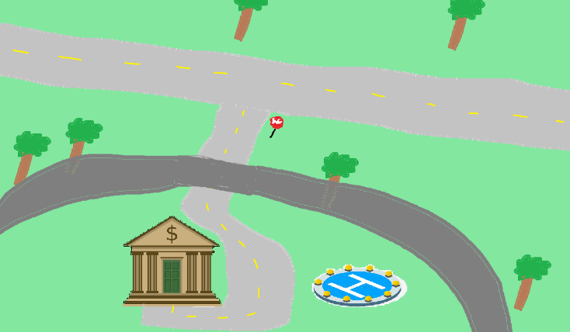
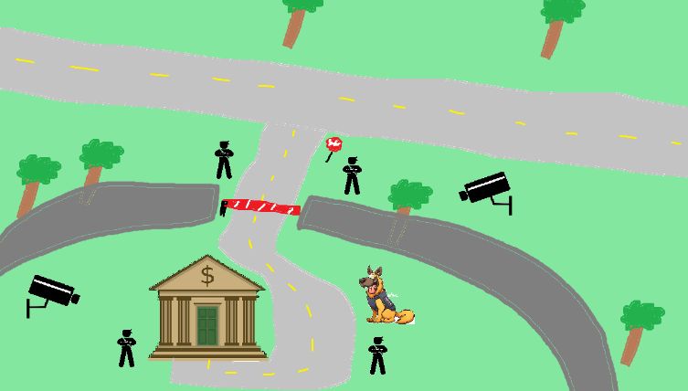
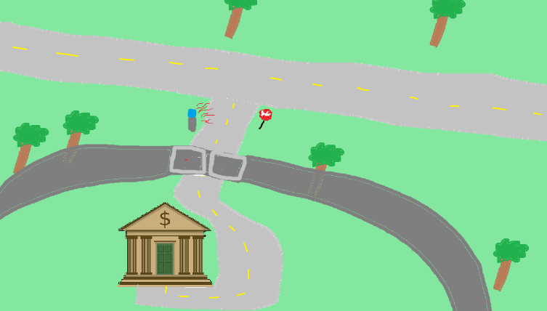
Perfect security is impossible

Slide 25
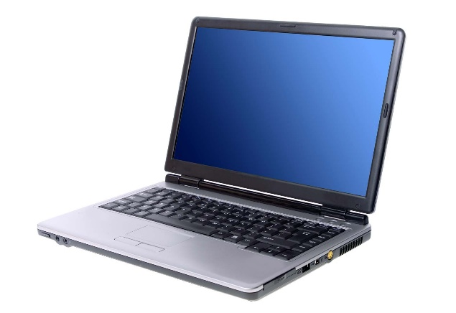
Perfect security is impossible
New assets

Slide 26
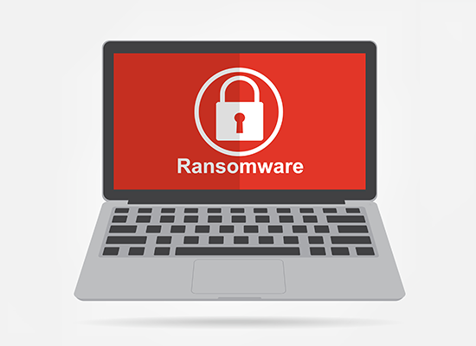
Perfect security is impossible
New assets
New threats

Slide 27
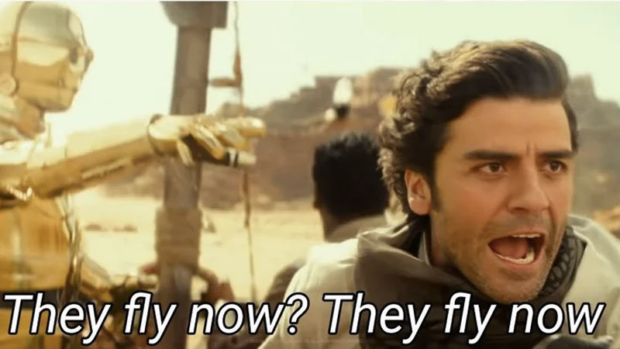
Perfect security is impossible
New assets
New threats
New capabilities

Slide 28

Perfect security is impossible
New assets
New threats
New capabilities
New technology

Slide 29
Perfect security is impossible
New assets
New threats
New capabilities
New technology
My goal is to teach you important cybersecurity principles that are universal across any system

Slide 30
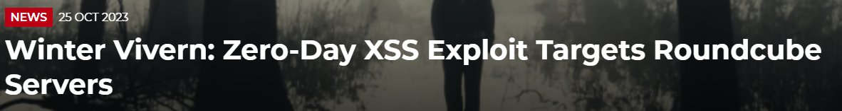
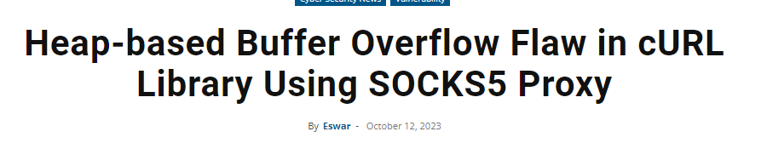
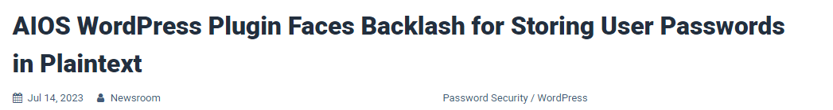
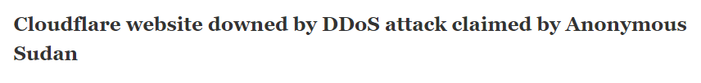

Slide 31
Threat Modeling
You develop a threat model by focusing on five key questions
What are you building?
What are the assets?
What can go wrong? What are the threats?
What mechanisms can we implement to prevent things from going wrong?
Did you do a decent job of analysis?

Slide 32
Threat Modeling
Brainstorming
Free-form brainstorming- gather around a whiteboard; enumerate threats/possible defenses
Scenario Analysis- Propose a scenario and ask “what might go wrong?”
Pre-Mortem- Assuming a failure or compromise, what do you do next?
Movie plotting – Pick outrageous ideas; what happens next?
Literature review- study systems that are similar to yours

Slide 33
Threat Modeling Practice
Free-form brainstorming- gather around a whiteboard; enumerate threats/possible defenses
Scenario Analysis- Propose a scenario and ask “what might go wrong?”
Pre-Mortem- Assuming a failure or compromise, what do you do next?
Movie plotting – Pick outrageous ideas; what happens next?
Literature review- study systems that are similar to yours
Let's develop a threat model
You are at a bar, and you hand your phone to a cute person …

Slide 34
Threat Modeling Practice
Free-form brainstorming- gather around a whiteboard; enumerate threats/possible defenses
Scenario Analysis- Propose a scenario and ask “what might go wrong?”
Pre-Mortem- Assuming a failure or compromise, what do you do next?
Movie plotting – Pick outrageous ideas; what happens next?
Literature review- study systems that are similar to yours
Let's develop a threat model
You are at a bar, and you hand your phone to a cute person …
What are you building?
What are the assets?
What can go wrong? What are the threats?
What mechanisms can we implement to prevent things from going wrong?
Did you do a decent job of analysis?

Slide 35
Structured Approaches
WE NEED STRUCTURE
Asset-centric: focus on things of value: things attack want; things you want to protect
Attacker-centric: focus on attackers/archetypes/personas and their capabilities
Software-centric: focus of SW; most SW is backed by structured models (CFG, State diagrams, etc)
Methodologies
STRIDE
Spoofing, Tampering, Repudiation, Info Disclosure, Denial of Service, Elevation of Privilege
Attack Trees
Attack Lists & Libraries (ie. Common and Current vulnerabilities)
(https://docs.microsoft.com/en-us/azure/security/develop/threat-modeling-tool-threats)
There is no “right” choice

Slide 36
Structured Approaches
On the final lab, you will need to use the knowledge you’ve learned in this class to develop a threat model for some kind of software system
Asset-centric: focus on things of value: things attack want; things you want to protect
Attacker-centric: focus on attackers/archetypes/personas and their capabilities
Software-centric: focus of SW; most SW is backed by structured models (CFG, State diagrams, etc)
Methodologies
STRIDE
Spoofing, Tampering, Repudiation, Info Disclosure, Denial of Service, Elevation of Privilege
Attack Trees
Attack Lists & Libraries (ie. Common and Current vulnerabilities)
(https://docs.microsoft.com/en-us/azure/security/develop/threat-modeling-tool-threats)
There is no “right” choice

Slide 37
Structured Approaches
Asset-centric: focus on things of value: things attack want; things you want to protect
Attacker-centric: focus on attackers/archetypes/personas and their capabilities
Software-centric: focus of SW; most SW is backed by structured models (CFG, State diagrams, etc)
Methodologies
STRIDE
Spoofing, Tampering, Repudiation, Info Disclosure, Denial of Service, Elevation of Privilege
Attack Trees
Attack Lists & Libraries (ie. Common and Current vulnerabilities)
(https://docs.microsoft.com/en-us/azure/security/develop/threat-modeling-tool-threats)
There is no “right” choice

Slide 38
Attack Trees
Goal: Open bank safe

Slide 39
Attack Trees
Goal: Open bank safe
Pick Lock
Learn Combo
Cut Open Safe
Improperly install safe

Slide 40
Attack Trees
Goal: Open bank safe
Pick Lock
Learn Combo
Cut Open Safe
Improperly install safe
Find written combo
Get combo from target

Slide 41
Attack Trees
Goal: Open bank safe
Pick Lock
Learn Combo
Cut Open Safe
Improperly install safe
Find written combo
Get combo from target
Threaten
Blackmail
Eavesdrop
Bribe

Slide 42
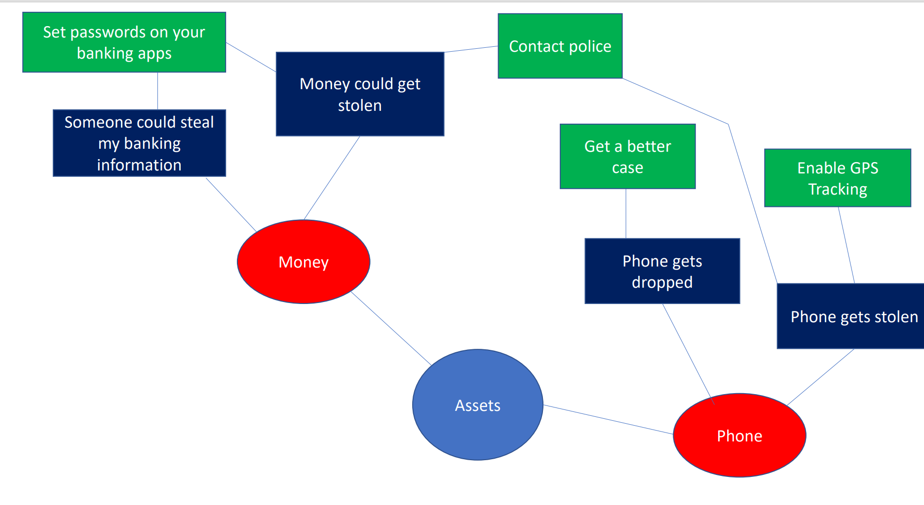
Mind Map

Slide 43
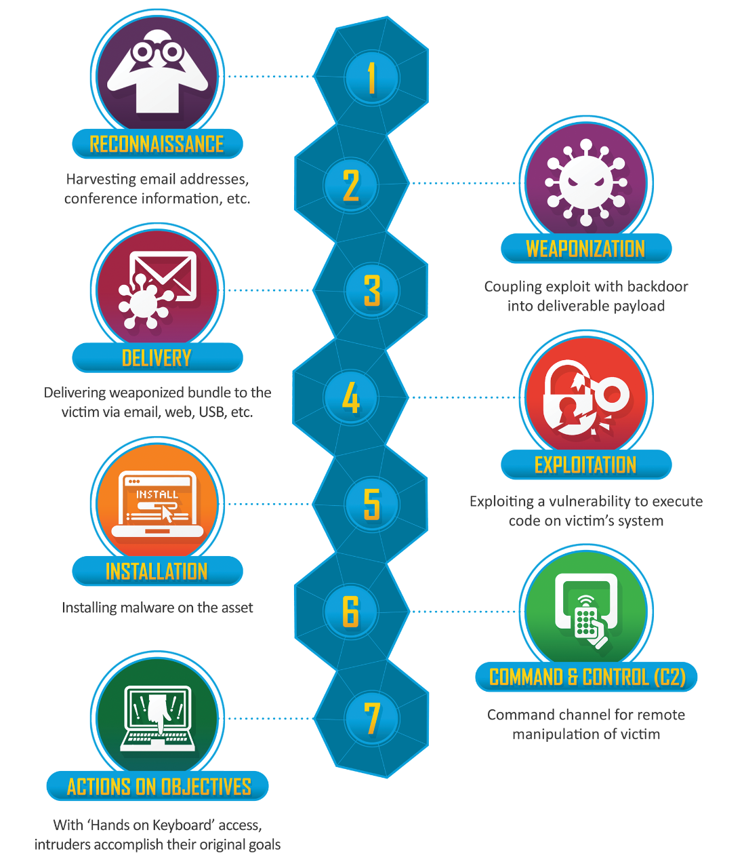
Be aware of the steps taken by a cybercriminal to conduct some cyber attack
“Cyber kill chain”

Slide 44
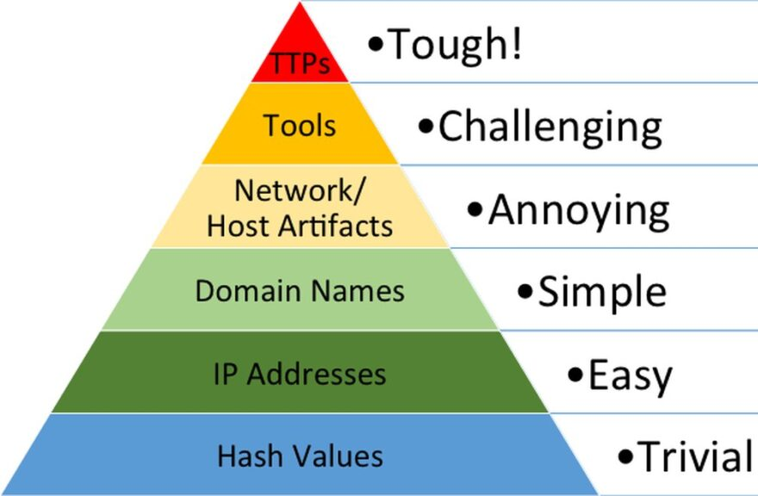
Responding to a threat can have varying levels of difficulty
Indicators of compromise (IOCs) refer to data that indicates a system may have been infiltrated by a cyber threat. They provide cybersecurity teams with crucial knowledge after a data breach or another breach in security.
“Pyramid of Pain”

Slide 45
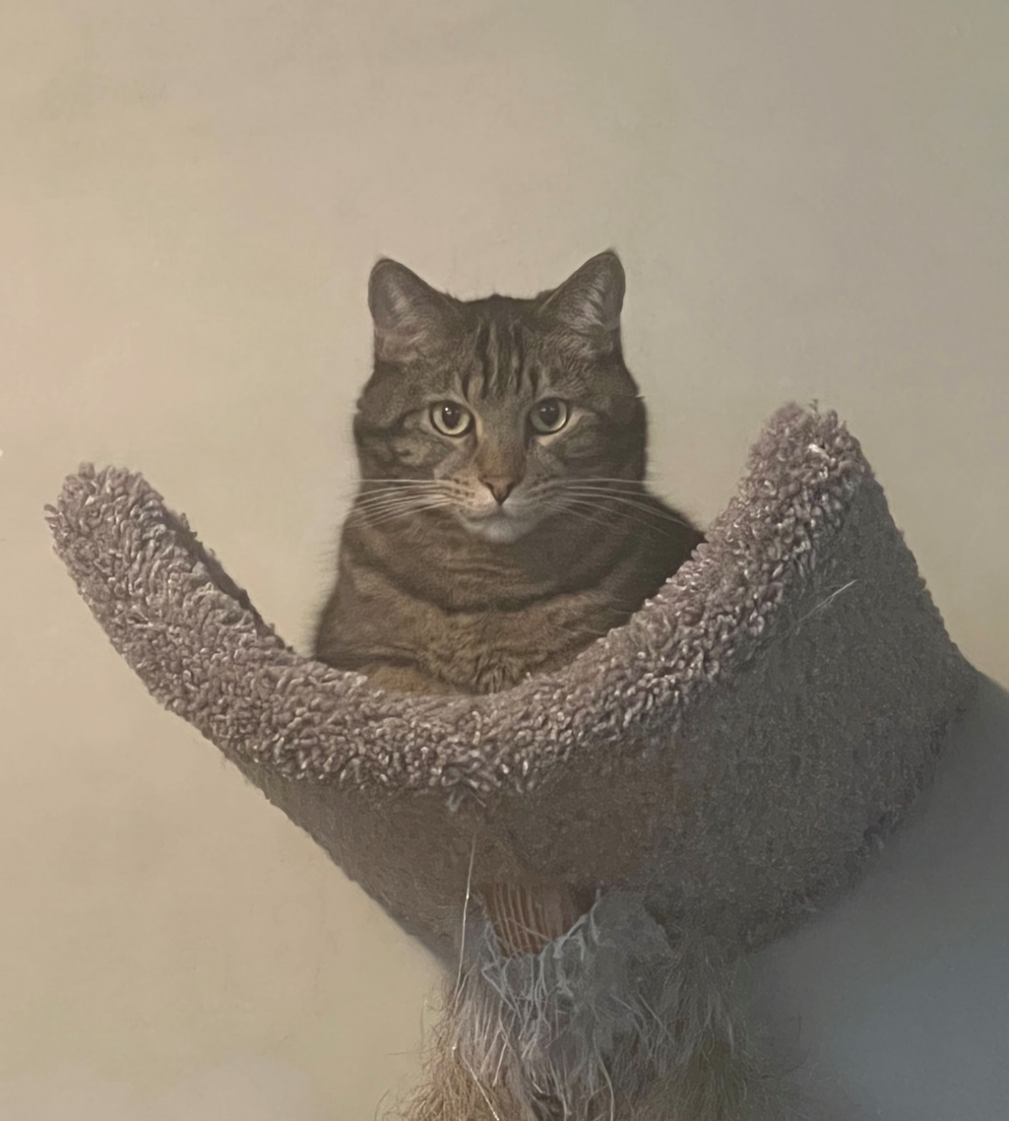

Slide 46
CSCI 476 Timeline
August
October
November
Software Security | Web Security | Network Security | Cryptography
Look at a variety of attacks in the realm of software security, web security, network security, cryptography
→ Learn the countermeasures for these attacks (and how effective they are)

Slide 47

SET-UID Programs
A SET-UID Program allows a user to run a program with the program owner’s privilege
User runs a program w/ temporarily elevated privileges
Every process has two User IDs
Real UID (RUID)– Identifies the owner of the process
Effective UID (EUID)– Identifies current privilege of the process
If a program owner == root,
The program runs with root privileges
Methods of Attack
Unsafe Function Calls (system() vs exec() )
Overwriting important ENV variables (PATH)
Overwriting important linking ENV variables (LD PRELOAD)

Slide 48
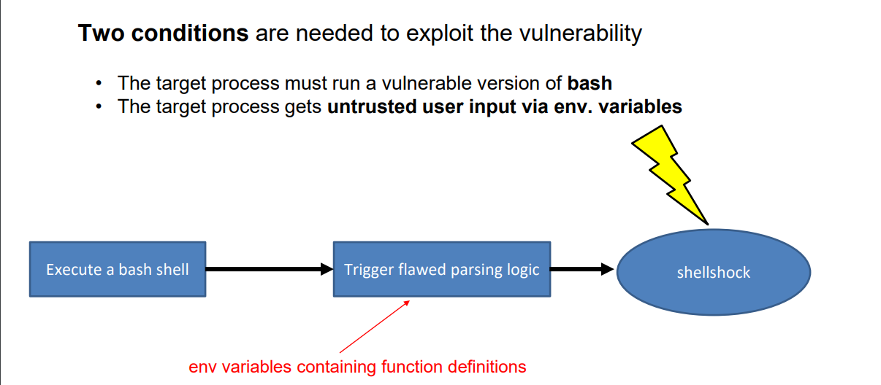
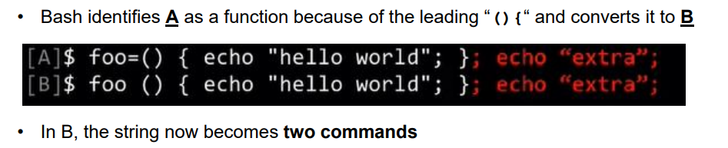
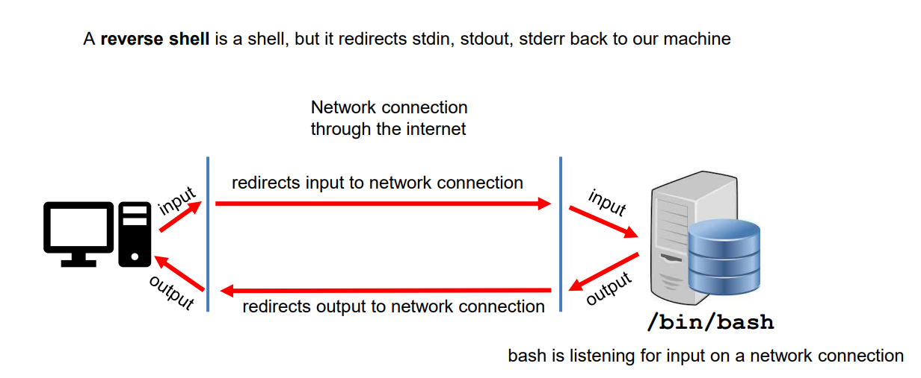
Shellshock Attack
Due to parsing logic in a vulnerable version of bash, we can export an environment variable that bash will interpret as a shell function
Example Payload

Slide 49
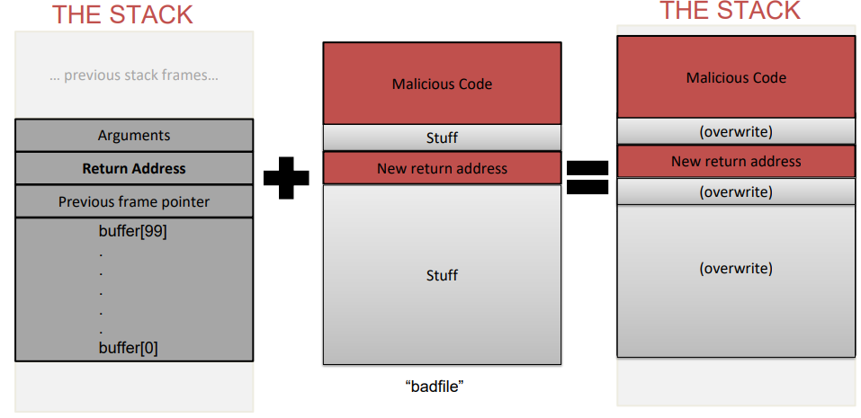
Buffer Overflow
When a program unsafely writes data to the stack via some buffer, we can overflow the buffer with our data
If we are smart, we can overwrite the return address and have the code jump to our malicious function
Countermeasures:
Secure Shell (/bin/dash)
ASLR
Stack Guard
Non-Executble Stack
To find the important locations in our stack, we used $ebp and $esp
The malicious code that we injected was shellcode
How did we bypass these countermeasures?
We filled overwrote everything else with NOPs

Slide 50
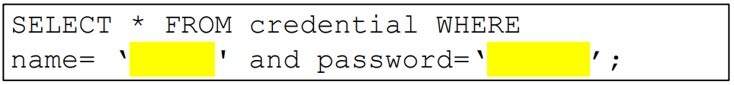
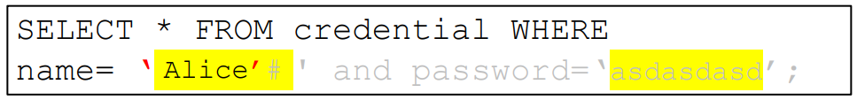
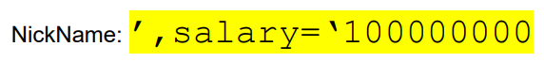
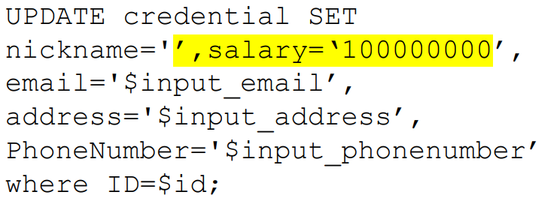
SQL Injection
It is common for user input to be inserted into a back-end SQL query. If an application is not careful about sanitizing user input, a user could supply an input that could be interpreted as SQL code and will interfere with the query
Username = Alice’#
Password = asdasdasd
Countermeasure: SQL Prepare() statements

Slide 51
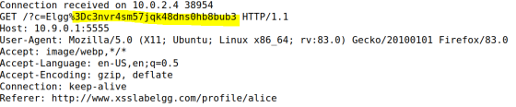
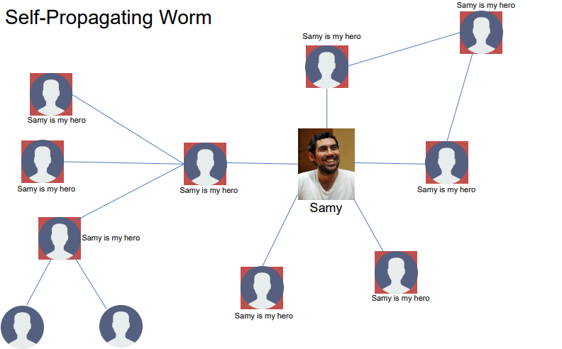
XSS Attack
Goal: Get someone else’s browser to execute our own JavaScript code
Vulnerability: Unsafe user input handling, and unsafe web communication policies
netcat server
Countermeasures:
Filtering
Encoding
CSP, CORS

Slide 52
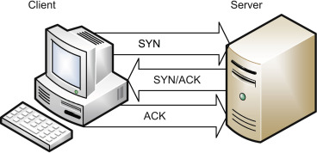
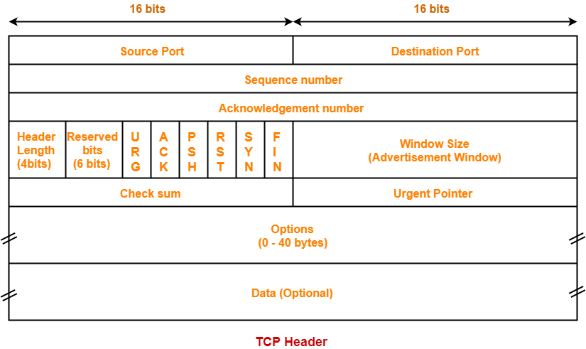
TCP Attacks
TCP Flooding- spoof a bunch of packets with bogus source IP addresses with the SYN flag. The server thinks these are legitimate requests and allocates computational resources for the request. We flood a server with these until the server can no longer accept new requests (and essentially denying service)
TCP Reset- Break an existing TCP connection by spoofing a TCP RST packet that looks like it came from one of the people in the existing TCP connection.
TCP Hijack- Hijack an existing TCP connection to get a TCP server to execute arbitrary commands. Spoofed a packet with the correct information so that the server thinks it came from the client

Slide 53



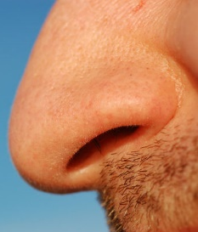

DNS Poisoning
A DNS cache poisoning attack is done by tricking a server into accepting malicious, spoofed DNS information
Instead of going to the IP address of the legitime website, they will go to the IP address that we place in our malicious DNS response (spoofed)
Internet
10.9.0.5
Client Container
10.9.0.53
Local DNS Server
Spoofed DNS
Response
Spoofed DNS
Response

Slide 54
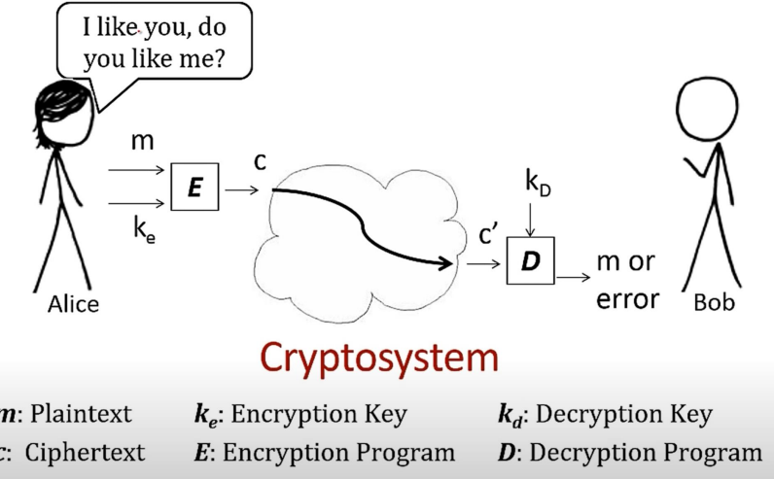

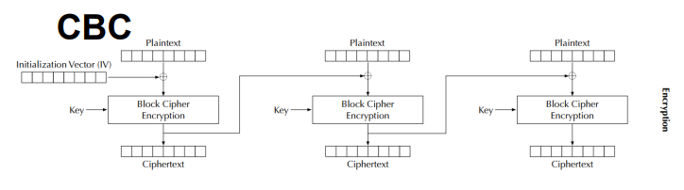
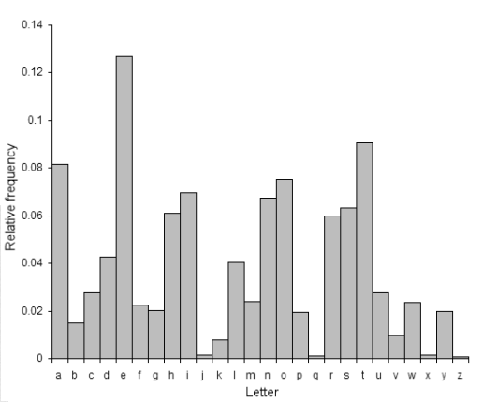
Symmetric Cryptography / Secret Key Encryption
Block Cipher (AES)
→ Split messages into fixed sized blocks, encrypt each block separately
Hello there world
01101000 01100101 01101100 01101100 01101111 00100000 01110100 01101000 01100101 01110010 01100101 00100000 01110111 01101111 01110010 01101100 01100100 00001010
Padding gets applied if the plaintext is not a multiple of the block size
Block 1
Block 2 Block 3
Frequency Analysis
(as a way to crack substitutions ciphers)
Ciphertext
An initialization vector (IV) is an arbitrary number that can be used with a secret key for data encryption
Modes of encryption: ECB, CBC, CFG, CTR, CFB

Slide 55
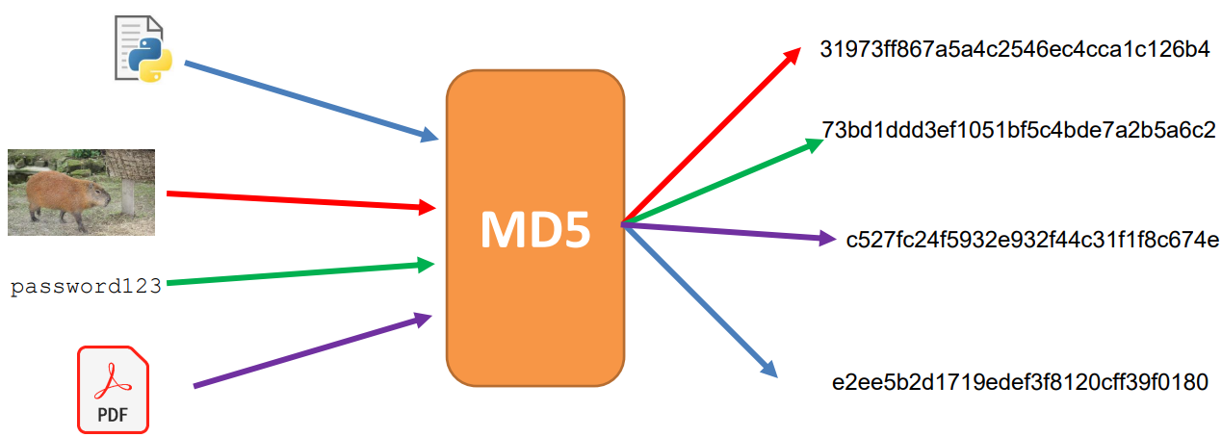
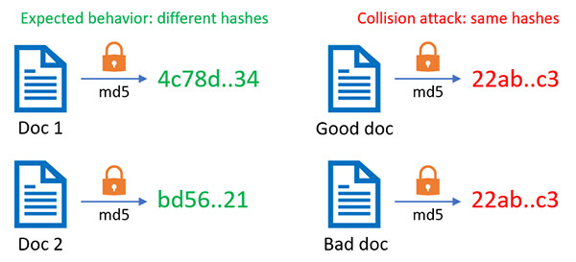
Hashing
Properties of Cryptographic Hash Function:
Given a hash, it should be difficult to reverse it
Given a message and it’s hash, it should be difficult to find another message that has the same hash
In general, difficult to calculate two values that have the same hash
Hash Collisions occur when two inputs map to the same hash, which can have some scary consequences
Applications of Hashing:
Message Integrity
Password Storing
Fairness and Commitment
Birthday Paradox

Slide 56
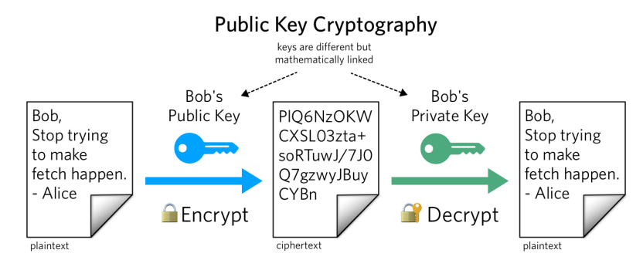
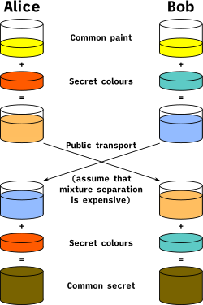
Asymmetric Cryptography / Public Key Encryption
Public Key vs Private Key (Mathematically linked)
Public key used to encrypt; Private key used to decrypt
Alice knows the prime products that generated her key, so it’s very easy for her to factorize
Eve does not know the products, and it is computationally infeasible for her to calculate the integer factorization of very large number
Diffie Helman Technique is used to transport a secret over an unsecure channel
RSA can not encrypt stuff that is larger than its key size,
So we typically will encrypt the key for a symmetric encryption algorithm (AES)
Private Keys are also used for digital signatures, which can be used to authenticate a message

Slide 57
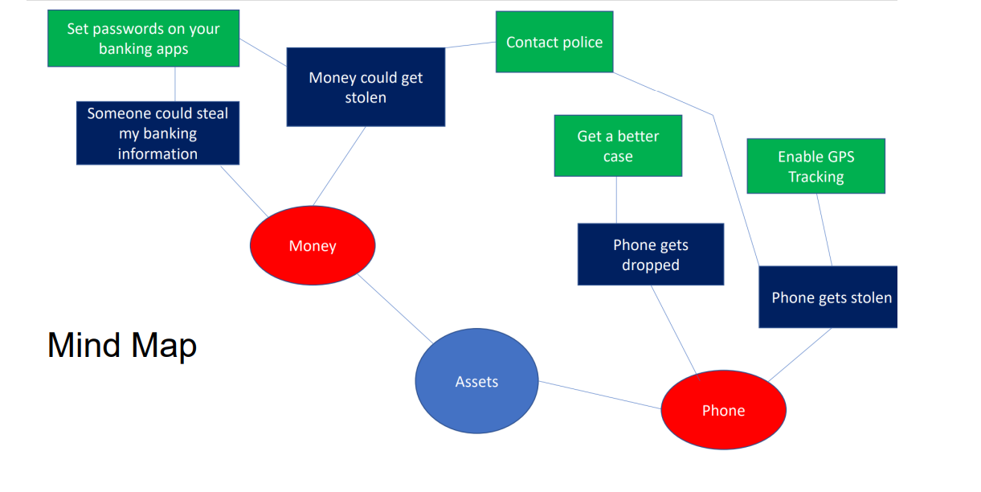
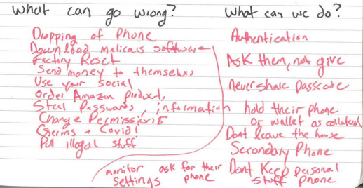
Threat Modeling
Threat modeling is a structured approach to assessing risk and defenses
What are you building?
What are the assets?
What can go wrong?
What should you do about those things that can go wrong?
Did you do a decent job of analysis?

Slide 58
CSCI 476 Course Outcomes
Understand important principles of security and threats to the CIA triad
Understand a variety of relevant vulnerabilities and defenses in software security (SETUID, Shellshock, Buffer Overflow)
Understand a variety of relevant vulnerabilities and defenses in network/web security (SQL Injection, XSS, TCP/IP attacks)
Understand a variety of relevant vulnerabilities and defenses in cryptography (Asymmetric, symmetric, One Way Hashing)
Given a system, develop a threat model, assess potential security weaknesses, and be able to think from the perspective of a threat actor
Make technical decisions during development of software with security in mind

Slide 59
Takeaways
Trust- Trust as little as possible. We never know for sure how a user will interact with software

Slide 60
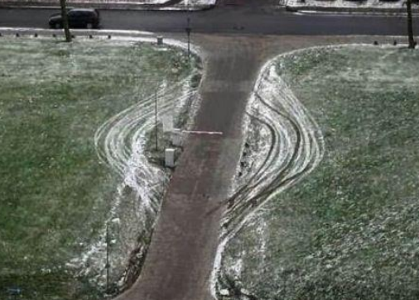
Takeaways
Trust- Trust as little as possible. We never know for sure how a user will interact with software
Intended Design- Users may interact with out system in ways that we did not think of.

Slide 61

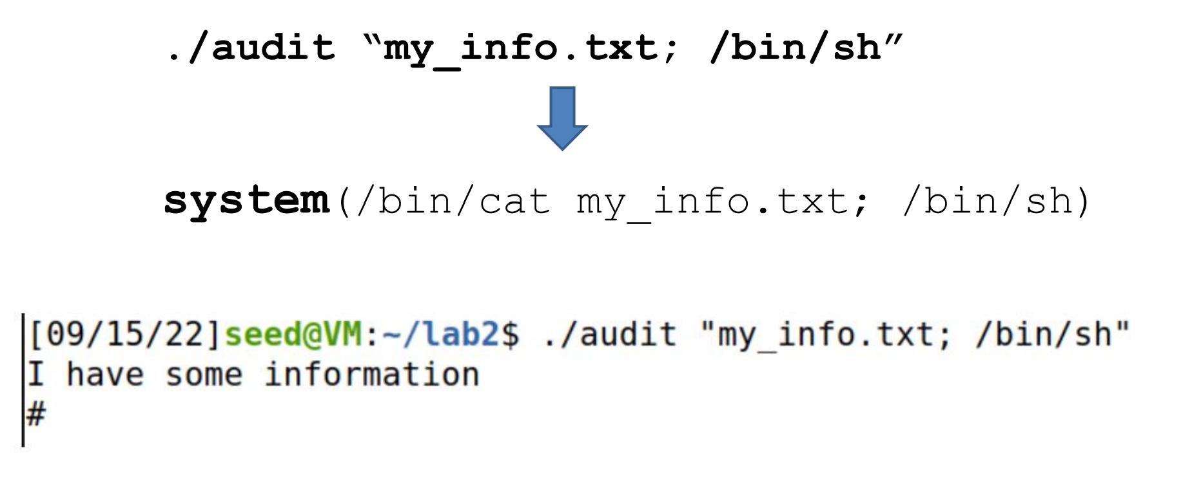
Takeaways
Trust- Trust as little as possible. We never know for sure how a user will interact with software
Intended Design- Users may interact with out system in ways that we did not think of.
Separation- There should always be a clear separation of code and data (user input)

Slide 62




Takeaways
Trust- Trust as little as possible. We never know for sure how a user will interact with software
Intended Design- Users may interact with out system in ways that we did not think of.
Separation- There should always be a clear separation of code and data (user input)
Control Flow Hijack- There should not be any way for an attacker to hijack the “natural flow of things”
Malicious Website
10.9.0.5
Client Container
10.9.0.53
Malicious DNS Server

Slide 63


Takeaways
Trust- Trust as little as possible. We never know for sure how a user will interact with software
Intended Design- Users may interact with out system in ways that we did not think of.
Separation- There should always be a clear separation of code and data (user input)
Control Flow Hijack- There should not be any way for an attacker to hijack the “natural flow of things”
Privilege- Privilege is a very powerful mechanism. We should never give more privilege than needed

Slide 64



Takeaways
Trust- Trust as little as possible. We never know for sure how a user will interact with software
Intended Design- Users may interact with out system in ways that we did not think of.
Separation- There should always be a clear separation of code and data (user input)
Control Flow Hijack- There should not be any way for an attacker to hijack the “natural flow of things”
Privilege- Privilege is a very powerful mechanism. We should never give more privilege than needed
Usability- Security and software should be useable. Too much security will push people away

Slide 65

Takeaways
Trust- Trust as little as possible. We never know for sure how a user will interact with software
Intended Design- Users may interact with out system in ways that we did not think of.
Separation- There should always be a clear separation of code and data (user input)
Control Flow Hijack- There should not be any way for an attacker to hijack the “natural flow of things”
Privilege- Privilege is a very powerful mechanism. We should never give more privilege than needed
Usability- Security and software should be useable. Too much security will push people away
Layering- Security should be happening at multiple layers
(Firewall → Input Sanitization → Authentication → Antivirus Scanner)
Countermeasures exist, but are they effective? And are they enabled?

Slide 66


Takeaways
Trust- Trust as little as possible. We never know for sure how a user will interact with software
Intended Design- Users may interact with out system in ways that we did not think of.
Separation- There should always be a clear separation of code and data (user input)
Control Flow Hijack- There should not be any way for an attacker to hijack the “natural flow of things”
Privilege- Privilege is a very powerful mechanism. We should never give more privilege than needed
Usability- Security and software should be useable. Too much security will push people away
Layering- Security should be happening at multiple layers
There be monsters- Vulnerabilities exist, and there will always be people that will try to exploit them

Slide 67
Perfect security is impossible
New assets
New threats
(ZERO days)
New capabilities
New technology

Slide 68

Takeaways
- Matt Revelle

Slide 69
Takeaways
Humans will always be the weakest link.
Social Engineering
Phishing
Writing bad code
Physical Security is also important

Slide 70
What’s next?
Cybersecurity Newsletters + Blogs
Dark Readings (https://www.darkreading.com/)
Schneier on Security (https://www.schneier.com/)
The Hacker News (https://thehackernews.com/)
Be aware of new vulnerabilities, new attacks
Cybersecurity Certificate and trainings
CompTIA
Security+
CySa
SANS
ISC2
Have hope
Cybersecurity-related Classes at MSU
CSCI 466 – Networks
CSCI 460 – Operating Systems
CSCI 351 – System Administration
CSCI 5XX – Intro to Malware

Slide 71



Thank You!
This class has been a blast to teach. Thank you for your patience, flexibility, kindness, and for laughing at my jokes ☺
I hope you enjoyed this class, and I hope the stuff you learned will be helpful in your career/future classes
If I can be of assistance to you for anything in the future (reference, advising, support), please let me know!
I will be teaching CSCI 132 and CSCI 232 next semester
Connect with me on LinkedIn!
If you find a job in cybersecurity, please keep in touch!
Congrats to those that are graduating next weekend! I hope you find a job that you love!

